Slide 1
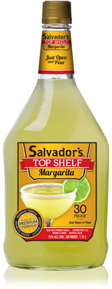
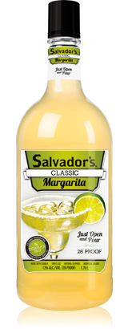
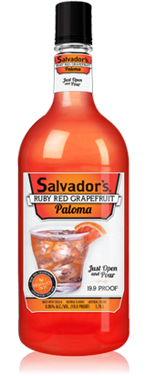
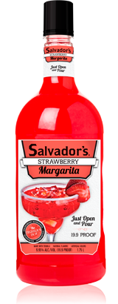
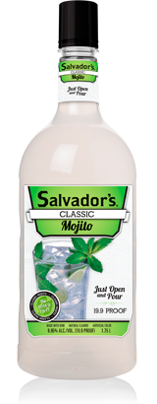
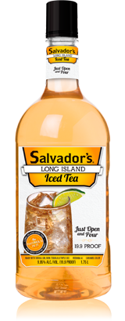
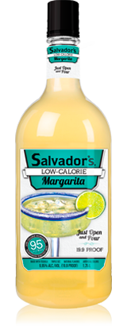
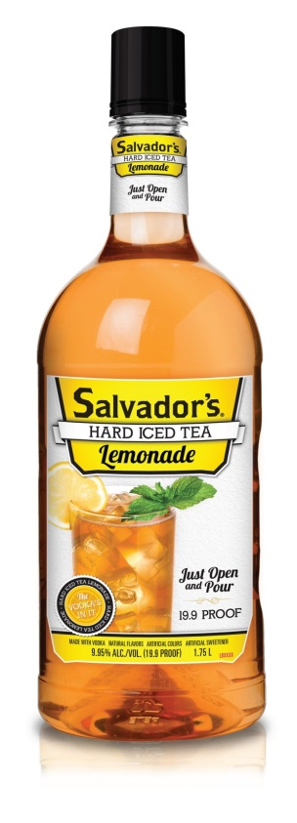

Slide 2
Salvador’s offers a strong line-up of 8 classic cocktails for any occasion
Made with the finest ingredients, our Top Shelf margarita stands strong with any of the best margaritas. Made with ultra premium tequila, premium triple sec, and produced at a strong 30 proof
Easy to drink and ready to serve, The original Salvador’s Margarita is made with premium tequila and never compromises on taste. 26 proof.
For a refreshing, thirst quenching tequila cocktail, the Paloma is definitely at the top of the list and it’s a favorite in Mexico. It’s a light, fruity drink made with the natural flavors of Ruby red grapefruits Truly one of the smoothest tequila drinks out there. 19.9 Proof
Perfectly sweet and delicious, Salvador’s take on the classic Strawberry Margarita is spot-on. 19.9 Proof.
Salvador’s Mojito is a classic, refreshing cocktail made with quality rum and a hint of natural mint sprig flavoring. 19.9 proof.
Made with premium vodka, gin, rum, tequila, and Triple Sec, Salvador’s Long Island Iced Tea is mixed to perfection. 19.9 Proof
Everything you love about Salvador’s Original Margarita, but with less calories (under 95 per serving). 19.9 Proof
A modern twist on a refreshing classic, Salvador’s Hard Iced Tea Lemonade is an exciting and refreshing addition to the world of spirits.
19.9 Proof

Slide 3
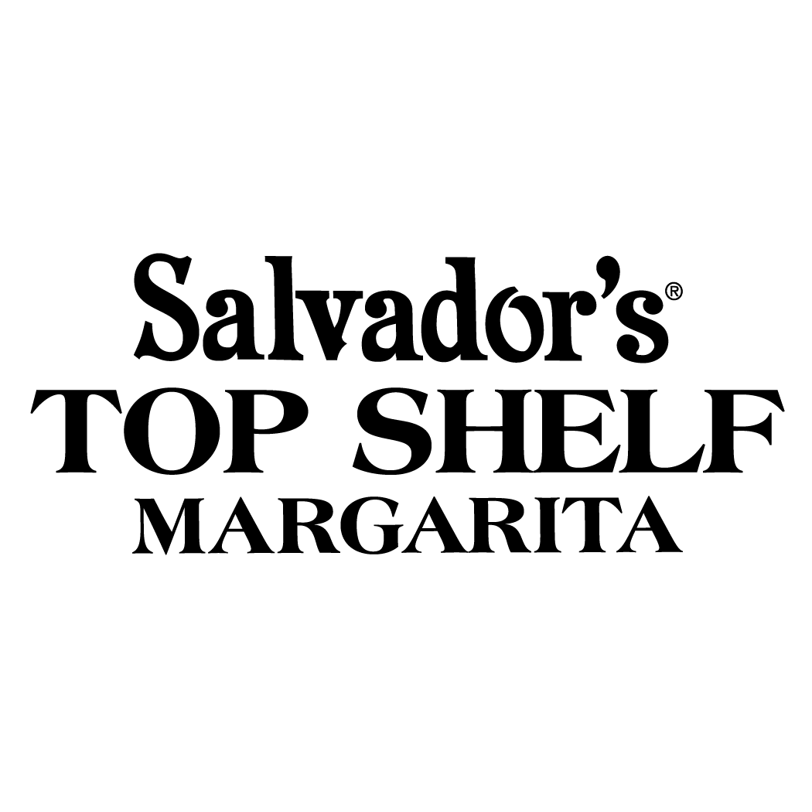
30 PROOF!
Made with the finest ingredients, our Top Shelf margarita stands strong with any of the best margaritas. Made with ultra premium tequila, premium triple sec, and produced at a strong 30 proof
Item # | Proof | Size | Pack | Weight | per Pallet | per Tier | Case Dimensions | UPC#
39772 | 30 | 1.75L Glass | 6 | 40.88 lbs. | 60 | 12 | 13” x 10 3/4” x 16” | 0-88352-12500-8
51242 | 30 | 1.75L Glass (Export) | 6 | 40.88 lbs. | 60 | 12 | 13” x 10 3/4” x 16” | 0-88352-12500-8
Please visit the Century Council for information and resources on how to fight drunk driving and stop underage drinking. PLEASE ENJOY RESPONSIBLY. @2017 Salvadors® Cocktails, 9.95-15% Alc./Vol. (19.9-30 Proof), Luxco®, Inc., St. Louis, MO
1.75L Top Shelf - Glass
1.75L Top Shelf - Glass (Export)

Slide 4
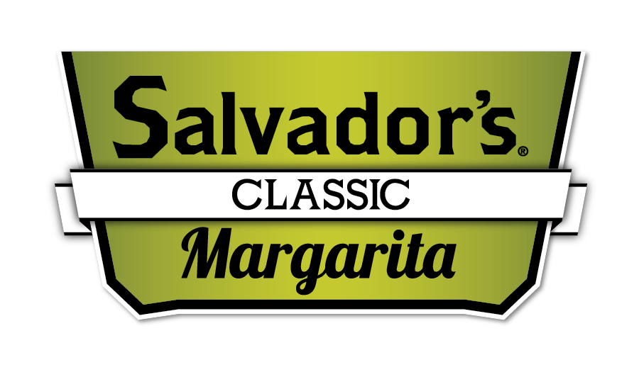
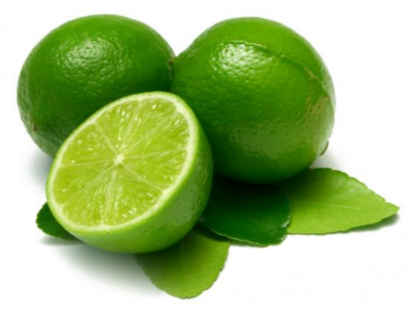
26 Proof
Classic Margarita
Easy to drink and ready to serve, The original Salvador’s Margarita is made with premium tequila and never compromises on taste.
Item # | Proof | Size | Pack | Weight | per Pallet | per Tier | Case Dimensions | UPC#
53819 | 26 | 200mL PET Round | 24 | 14.42 lbs. | 120 | 12 | 14 3/4” x 9 7/8” x 6 5/8” | 0-88352-12885-6
53812 | 26 | 1.75L PET Custom | 6 | 27 lbs. | 65 | 13 | 13 3/8” x 10” x 14” | 0-88352-12858-0
54032 | 26 | 1.75L PET Custom w/ Sunglasses | 6 | 27 lbs. | 65 | 13 | 13 3/8” x 10” x 14” | 0-88352-12858-0
200mL Margarita (PET)
1.75L Margarita (PET)
1.75L Margarita (PET w/ Sunglasses)
Please visit the Century Council for information and resources on how to fight drunk driving and stop underage drinking. PLEASE ENJOY RESPONSIBLY. @2017 Salvadors® Cocktails, 9.95-15% Alc./Vol. (19.9-30 Proof), Luxco®, Inc., St. Louis, MO

Slide 5
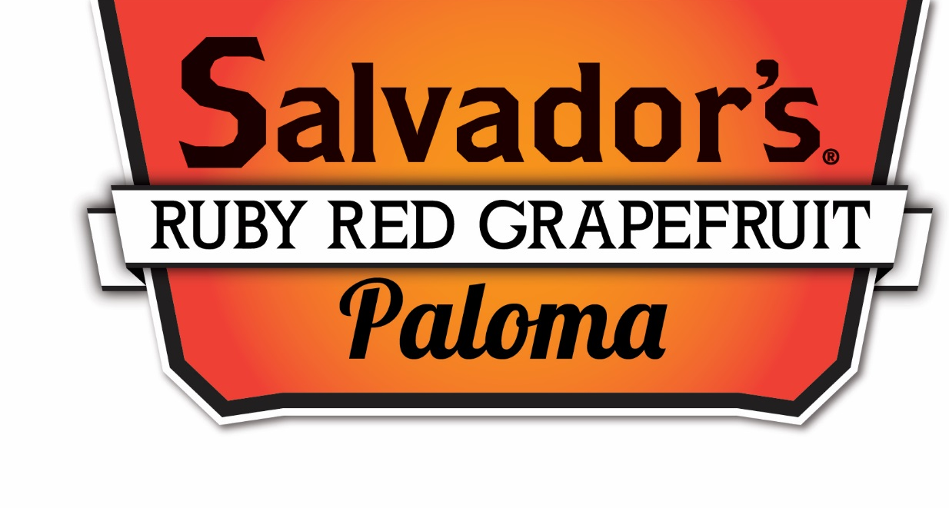
19.9 Proof
Ruby Red
Grapefruit Paloma
For a refreshing, thirst quenching tequila cocktail, the Paloma is definitely at the top of the list and it’s a favorite in Mexico. It’s a light, fruity drink made with the natural flavors of Ruby red grapefruits Truly one of the smoothest tequila drinks out there. 19.9 Proof
Item # | Proof | Size | Pack | Weight | per Pallet | per Tier | Case Dimensions | UPC#
55109 | 19.9 | 200mL PET Round | 24 | 13.25 lbs. | 120 | 12 | 14 3/4” x 9 7/8” x 6 5/8” | 0-88352-13020-0
55102 | 19.9 | 1.75L PET Custom | 6 | 26.21 lbs. | 65 | 13 | 13 3/8” x 10” x 14” | 0-88352-13019-4
200mL Round – 24in
1.75L – 6in

Slide 6
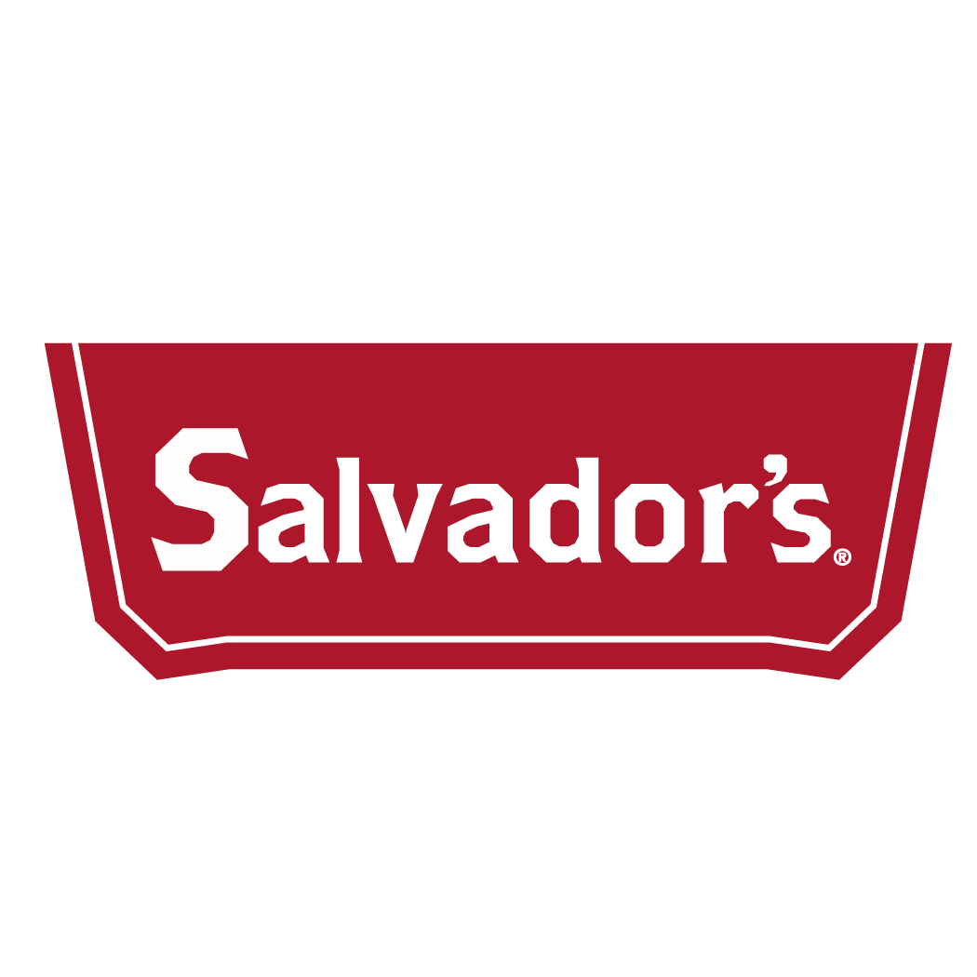
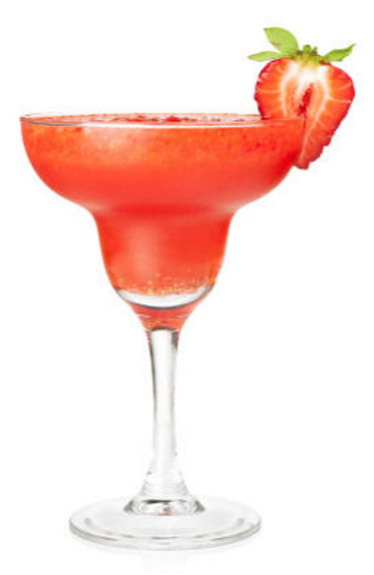
19.9 Proof
Strawberry Margarita
Perfectly sweet and delicious, Salvador’s take on the classic Strawberry Margarita is spot-on. 19.9 Proof.
Item # | Proof | Size | Pack | Weight | per Pallet | per Tier | Case Dimensions | UPC#
52849-NP | 19.9 | 200mL PET Round | 24 | 13.38 lbs. | 120 | 12 | 14 3/4” x 9 7/8” x 6 5/8” | 0-88352-12060-7
52842-NP | 19.9 | 1.75L PET Custom | 6 | 27.02 lbs. | 65 | 13 | 13 3/8” x 10” x 14” | 0-88352-12005-8
Please visit the Century Council for information and resources on how to fight drunk driving and stop underage drinking. PLEASE ENJOY RESPONSIBLY. @2017 Salvadors® Cocktails, 9.95-15% Alc./Vol. (19.9-30 Proof), Luxco®, Inc., St. Louis, MO
200mL Round PET – 24in
1.75L PET – 6in

Slide 7
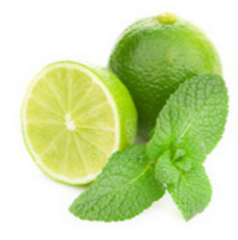
19.9 Proof
Mojito Cocktail
Salvador’s Mojito is a classic, refreshing cocktail made with quality rum and a hint of natural mint sprig flavoring.
Item # | Proof | Size | Pack | Weight | per Pallet | per Tier | Case Dimensions | UPC#
52839-NP | 19.9 | 200mL PET Round | 24 | 13.25 lbs. | 120 | 12 | 14 3/4” x 9 7/8” x 6 5/8” | 0-88352-12453-7
52832-NP | 19.9 | 1.75L PET Custom | 6 | 27 lbs. | 65 | 13 | 13 3/8” x 10” x 14” | 0-88352-12448-3
53322 | 22 | 1.75L PET - Canada | 6 | 26.21 lbs. | 65 | 13 | 13 3/8” x 10” x 14” | 0-88352-12856-6
200mL PET– 24in
1.75L PET – 6in
1.75L PET – Canada (22 proof)
Please visit the Century Council for information and resources on how to fight drunk driving and stop underage drinking. PLEASE ENJOY RESPONSIBLY. @2017 Salvadors® Cocktails, 9.95-15% Alc./Vol. (19.9-30 Proof), Luxco®, Inc., St. Louis, MO

Slide 8
19.9 Proof
Long Island Iced Tea
Made with premium vodka, gin, rum, tequila, and Triple Sec, Salvador’s Long Island Iced Tea is mixed to perfection.
Item # | Proof | Size | Pack | Weight | per Pallet | per Tier | Case Dimensions | UPC#
52829-NP | 19.9 | 200mL PET Round | 24 | 14.75 lbs. | 120 | 12 | 14 3/4” x 9 7/8” x 6 5/8” | 0-88352-12460-5
52822-NP | 19.9 | 1.75L PET Custom | 6 | 28 lbs. | 65 | 13 | 13 3/8” x 10” x 14” | 0-88352-12455-1
Please visit the Century Council for information and resources on how to fight drunk driving and stop underage drinking. PLEASE ENJOY RESPONSIBLY. @2017 Salvadors® Cocktails, 9.95-15% Alc./Vol. (19.9-30 Proof), Luxco®, Inc., St. Louis, MO
200mL PET Round – 24in
1.75L PET Custom – 6in

Slide 9
19.9 Proof
Low-Calorie
Margarita
Everything you love about Salvador’s Original Margarita, but with less calories.
Under 95 calories per serving!
Item # | Proof | Size | Pack | Weight | per Pallet | per Tier | Case Dimensions | UPC#
52269-NP | 19.9 | 200mL PET Round | 24 | 14.75 lbs. | 120 | 12 | 14 3/4” x 9 7/8” x 6 5/8” | 0-88352-12013-3
52262-NP | 19.9 | 1.75L PET Custom | 6 | 26.21 lbs. | 65 | 13 | 13 3/8” x 10” x 14” | 0-88352-12008-9
Please visit the Century Council for information and resources on how to fight drunk driving and stop underage drinking. PLEASE ENJOY RESPONSIBLY. @2017 Salvadors® Cocktails, 9.95-15% Alc./Vol. (19.9-30 Proof), Luxco®, Inc., St. Louis, MO
200mL Round – 24in
1.75L Custom – 6in

Slide 10
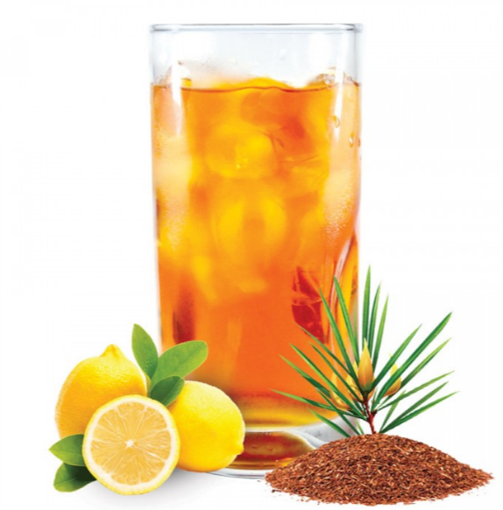
19.9 Proof Hard Iced Tea Lemonade
A modern twist on a refreshing classic, Salvador’s Hard Iced Tea Lemonade is an exciting and refreshing addition to the world of spirits.
Item # | Proof | Size | Pack | Weight | per Pallet | per Tier | Case Dimensions | UPC#
56849 | 19.9 | 200mL PET Round | 24 | 15 lbs. | 120 | 12 | 14 3/4” x 9 7/8” x 6 5/8” | 0-88352-13106-1
56842 | 19.9 | 1.75L PET Custom | 6 | 26 lbs. | 65 | 13 | 13 3/8” x 10” x 14” | 0-88352-13105-4
Please visit the Century Council for information and resources on how to fight drunk driving and stop underage drinking. PLEASE ENJOY RESPONSIBLY. @2017 Salvadors® Cocktails, 9.95-15% Alc./Vol. (19.9-30 Proof), Luxco®, Inc., St. Louis, MO

