Slide 2
US domestic vodka is growing in terms of volume sales and price per unit and is now double the size of imported Vodka in the US.
According to Nielsen’s August 2016 total spirits report, Imported Vodka is seeing a +1.2% change in dollar sales over the past 52 weeks, but Domestic Vodka is far outpacing that growth at 7.3%.
In terms of total dollars, domestic Vodka is double that of imported Vodka.
TOTAL DOMESTIC 52 WEEKS ENDING
SIZE | DOLLAR SALES | DOLLAR SALES CHG | % CHG | PRICE PER UNIT | PRICE PER UNIT CHG
DOMESTIC | $828,100,179 | $44,967,001 | 6% | N/A | N/A
1.75LT | $414,925,926 | $14,143,983 | 4% | $15.63 | $0.47
0.75LT | $334,622,910 | $22,127,775 | 7% | $10.84 | $0.16
0.375LT | $31,989,654 | $3,024,731 | 10% | $5.05 | ($0.05)
1LT | $27,309,954 | $3,259,855 | 14% | $13.63 | $0.75
0.2LT | $9,919,321 | $496,765 | 5% | $2.59 | $0.02
0.05LT | $8,353,945 | $1,907,464 | 30% | $1.19 | $0.03
0.1LT | $977,327 | $5,860 | 1% | $1.97 | ($0.02)
0.5LT | $1,140 | $567 | 99% | $0.82 | ($0.37)
Source: Vodka IRI Report 2016

Slide 3
“Gluten Free” is a product attribute that continues to grow across categories.
According to Mintel (Dec 2015), the gluten-free foods category experienced growth of 136% from 2013–2015.
The global gluten-free packaged food market is projected to grow at a compound annual growth rate of approximately 6% between 2015 and 2019
Younger generations, specifically 38% of Generation Z and 32% of millennials, said they are willing to pay a premium for gluten-free products.
Source: http://www.foodbusinessnews.net/articles/news_home/Consumer_Trends/2016

Slide 4
Pearl Vodka – NOW DOMESTIC AND GLUTEN FREE!
Demand for domestic Vodka is greater than imported in the US
According to Nielsen’s August 2016 total spirits report, Imported Vodka is seeing a +1.2% Change in dollar sales over the past 52 weeks, but Domestic Vodka is far outpacing that growth at 7.3%.
In terms of total dollars, domestic Vodka is double that of imported Vodka.
Allows us to know be Gluten Free, in keeping with consumer trends
According to Mintel (Dec 2015), the gluten-free foods category experienced growth of 136% from 2013–2015.

Slide 5
About Pearl Vodka - Domestic
What we’re made of…
Produced and bottled in the USA
Sourced from 100% US grain
Made with Midwest Corn—gluten free!
Double carbon filtered for a clean, classic taste
Expertly crafted in small batches
Distilled five times and filtered for ultimate smoothness
Our variety sets us apart…
Pearl will still offer a wide a variety of quality flavors and SKUs

Slide 6
Awards for the Pearl Domestic formulation
Pearl Original
2017 San Francisco World Spirits Competition: Gold
2017 SIP Awards: Platinum
2017 Ultimate Spirits Challenge: 88 points; Great Value Award
2017 Tastings.com: 93 points; Gold Medal; Best Buy Award
Pearl Cucumber
2017 San Francisco World Spirits Competition: Silver

Slide 7
Target Consumer
Adults 21-45 year old co-ed
Skew 60% female
Influencers in their social group
Enjoys entertaining at home, craft cocktails and cooking
Will pay slightly more for superior, high quality products
Likely to try new local or domestic brands
Primarily off-premise purchaser, in grocery, liquor or convenience stores. Promotions and samples are influential to the core vodka drinker.
Households with higher income, around $75k– looking for quality at a good price.
Heavy user of Facebook, Pinterest and possibly Instagram. Health conscious and follows workout and diet trends. Favor Netflix and other streaming services over cable. Prioritize quality time with family and friends. Favor Target and Amazon.com
Typically skews toward unflavored vodka. Female more likely to drink flavored vodka. Sometimes mixed with juice or soda, the core consumer are less likely to drink with these mixers and are more likely to drink with unflavored additions like water or club soda.
Sources: MRI, Spring 2013; Mintel, 2013; Mintel, October 2015

Slide 8
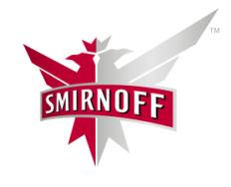
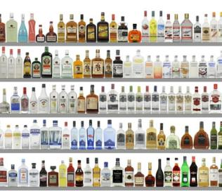
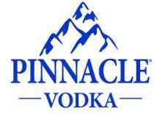
Pearl Vodka Brand Guidelines
Priority Product Mix | Competitive Target Set | Shelf Position | Suggested Retail Price | Goals
Off-Premise 750mL 1.75L | Svedka Smirnoff Pinnacle New Amsterdam | Adjacent to competitive target set | Everyday Retail: 750ml: $12.99-$13.99 1.75L: $19.99-$21.99 Promotional Price: 750ml: $10.99-$11.99, (Not < $10) 1.75L: $17.99-$20.99, (Not < $17.99) | Grow off premise volume Focus on Core + 3 Strategy
On-Premise Premium Well Placement: : 1L |  | Premium Well or Back Bar |  | Grow On-Premise POD’s Premium Well Placement Maintain Placement

Slide 9
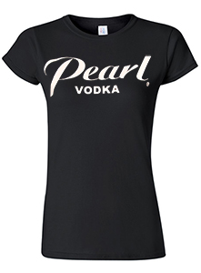
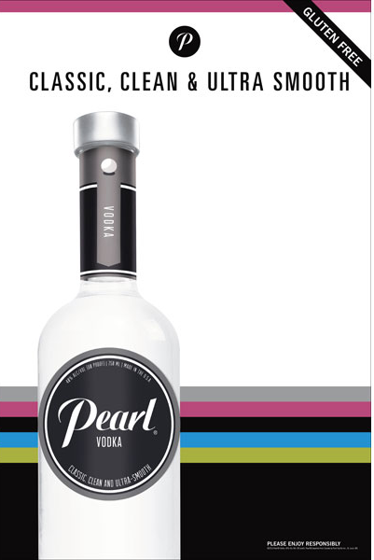
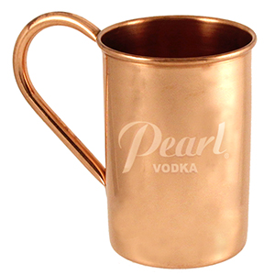
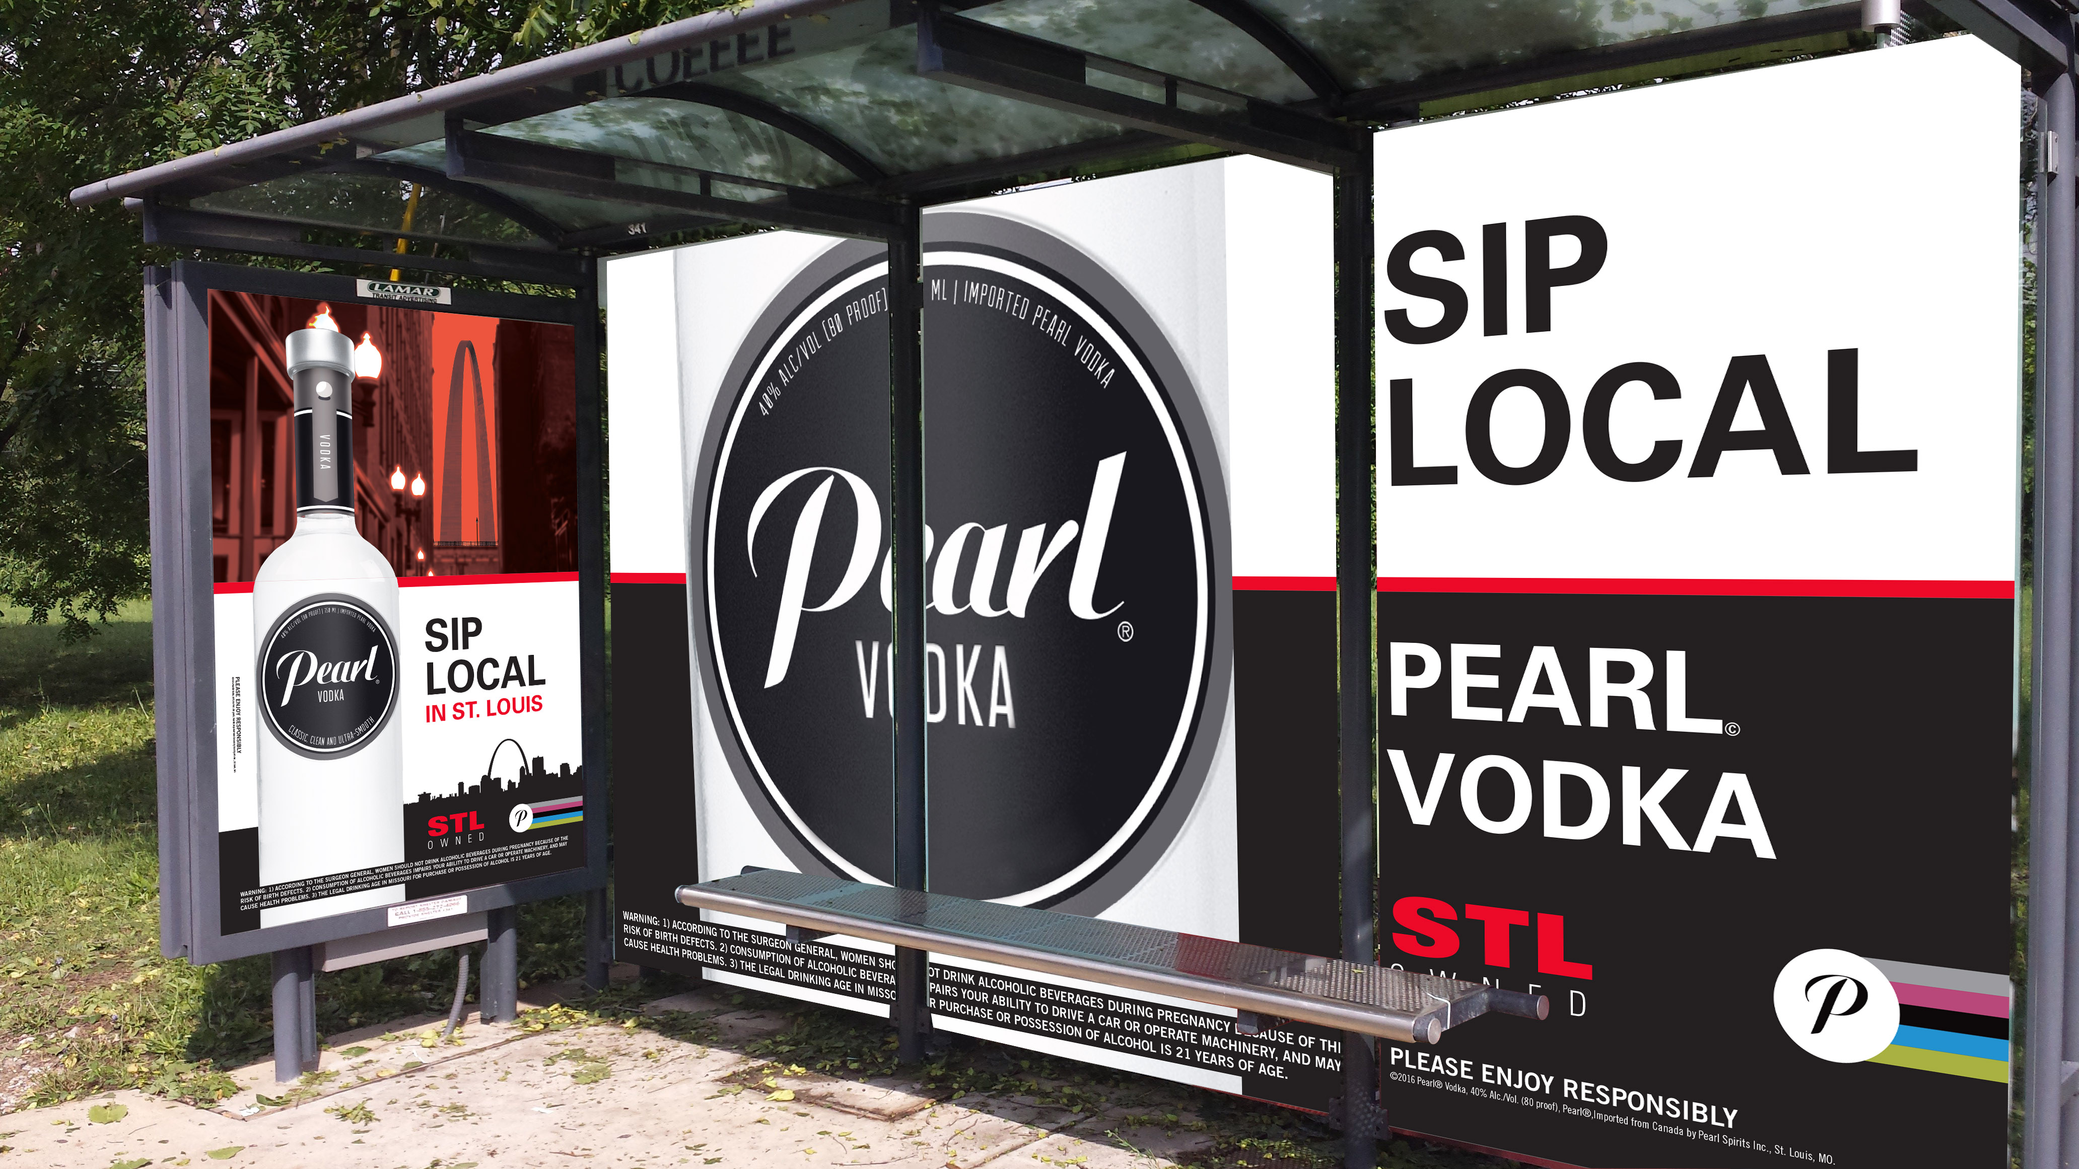
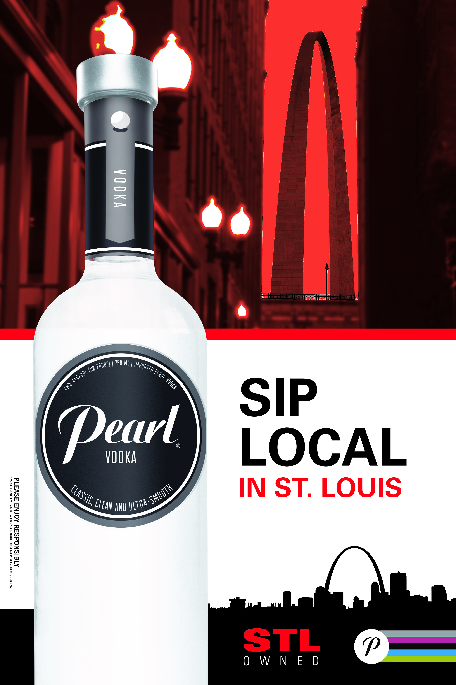
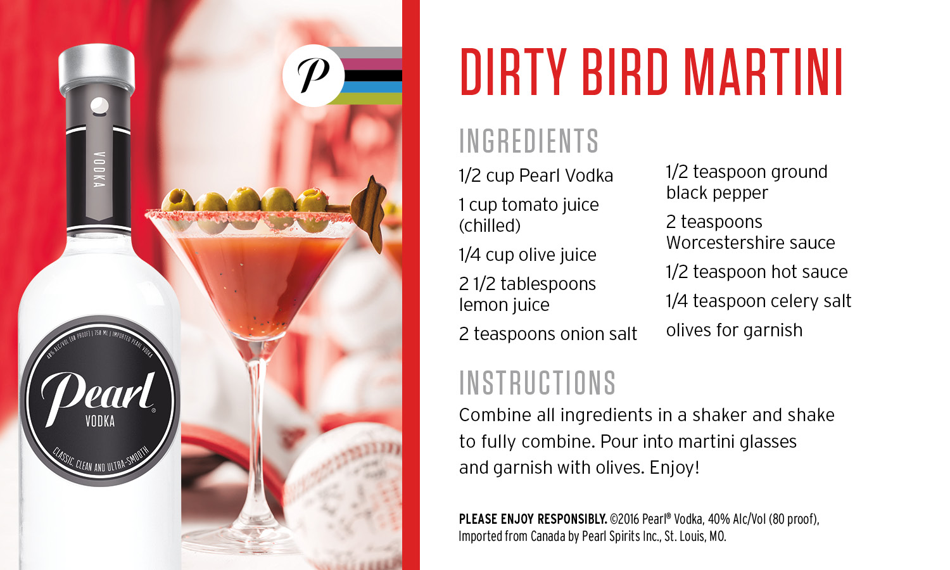
2017 Pearl Programs
Year-Round National
Digital Media and Ibotta Support
Iconic POS and Merchandising
STL Local Focus

